Slide 1
It is a system for managing and saving all hotel data
SuperMarket System
Dr:- Ibrahim El-Semman

Slide 2
Team Member
رامي منازع علام (IT)
يوسف السيد يوسف (CS3)
محمود محمد ابوضيف (IT)
يوسف احمد نجاح(CS3)
المختار احمد عبدالغني (IT)

Slide 3
Project erd

Slide 4
Project Description
Contains 10 shapes. The basic form has one option to log in as an User, and this can be done with a username and password.
.
When entering as an user, customers can sell, add, delete or modify a product, add suppliers, buy from them, and review invoices.
The second form contains the basic data of the supermarket, through which it is possible to perform all the above-mentioned powers and exit from the program.

Slide 5
Project Forms
Login form requires name and password.
The second form contains the basic data of the supermarkrt, through which one can enter the other forms.
Reports form
Add product form
Add employee form
product list form
sales bill form
purchase bill form
Suppliers form
Customers form

Slide 6
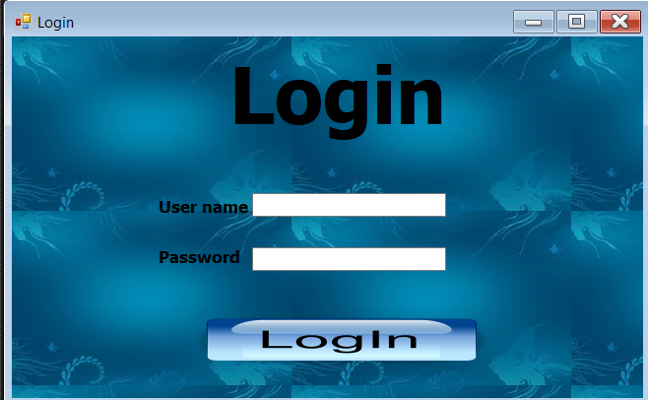
Login form
Login form requires name and password
To access

Slide 7
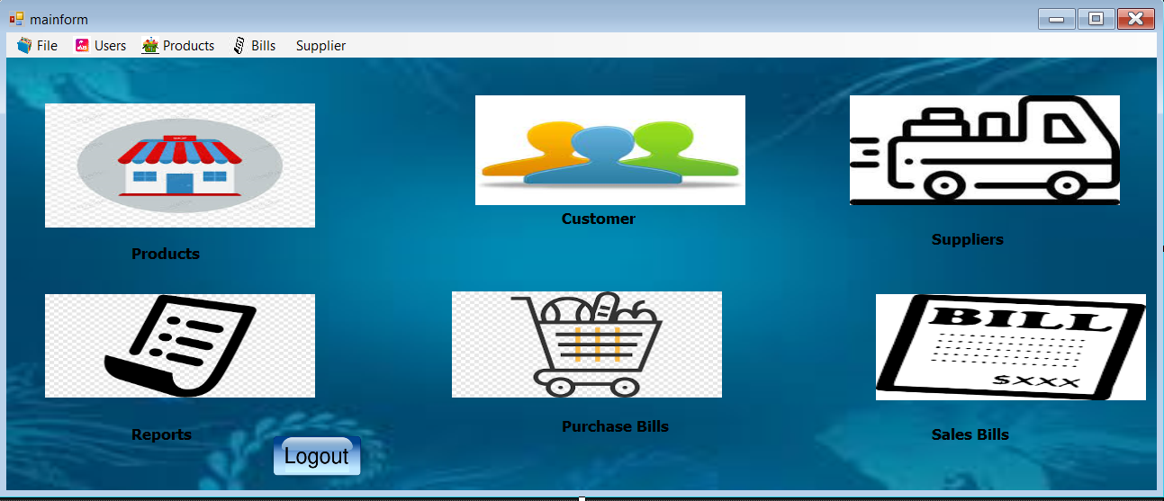
Main form
It is possible to access the rest of the forms

Slide 8
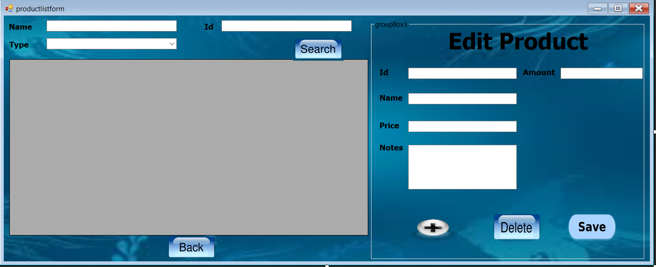
Products List form
You can search for products by name, type or Id, modify and delete product data, and can access the add product form

Slide 9
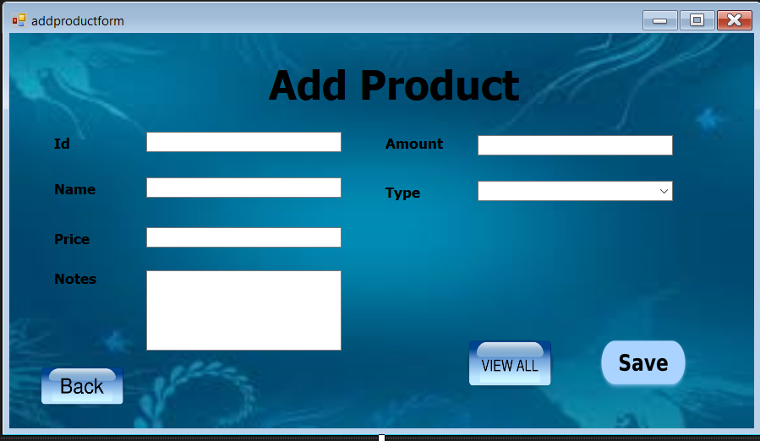
Add Product form
You can add new product data, save it, and access a Product List form

Slide 10
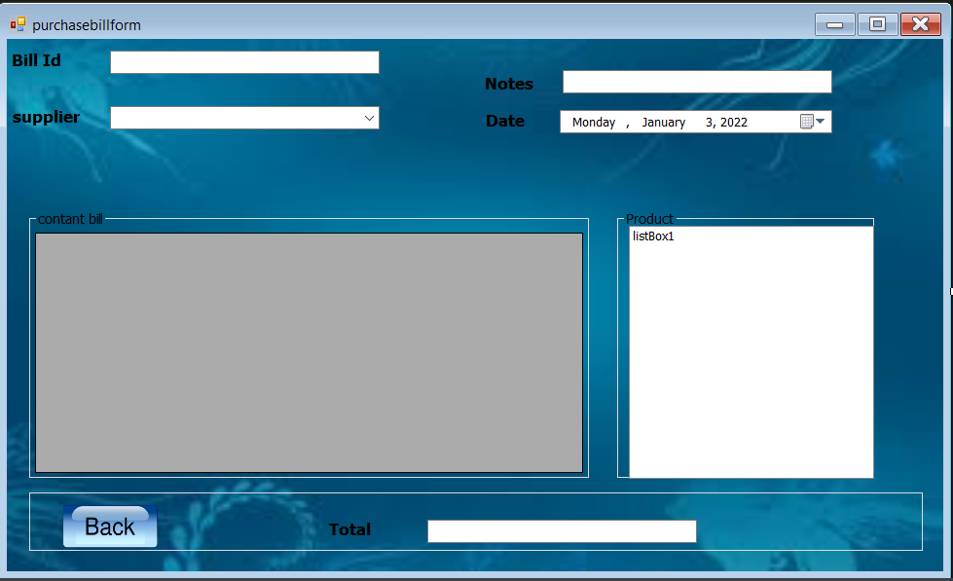
purchase bill form
Here you can buy from suppliers after specifying the supplier's name, date and bill id.

Slide 11
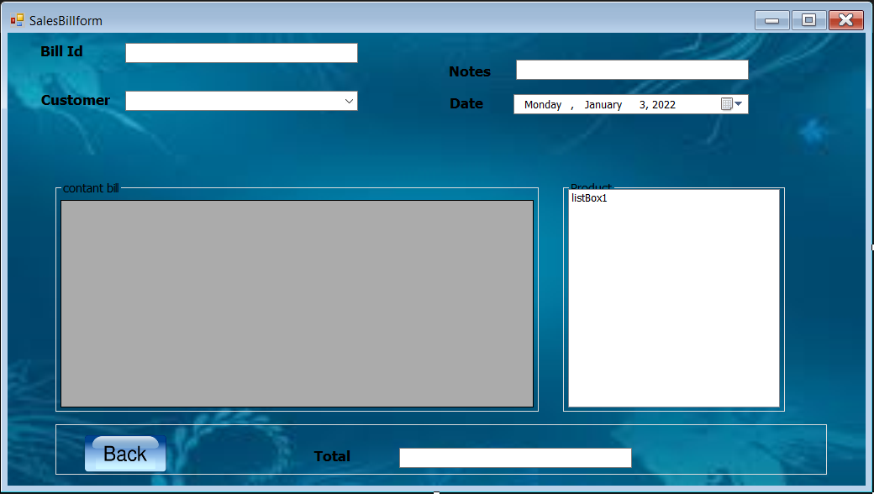
sales bill form
Here you can sell to customers after specifying the customer's name, date and bill id.

Slide 12
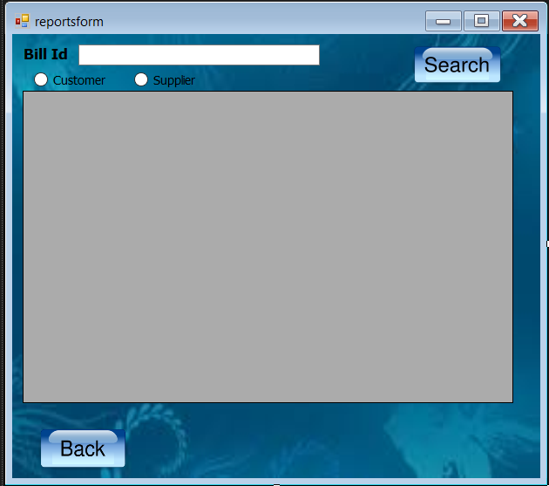
Reports form
Here you can review the bill by id after determining the type of bill for a customer or supplier

Slide 13
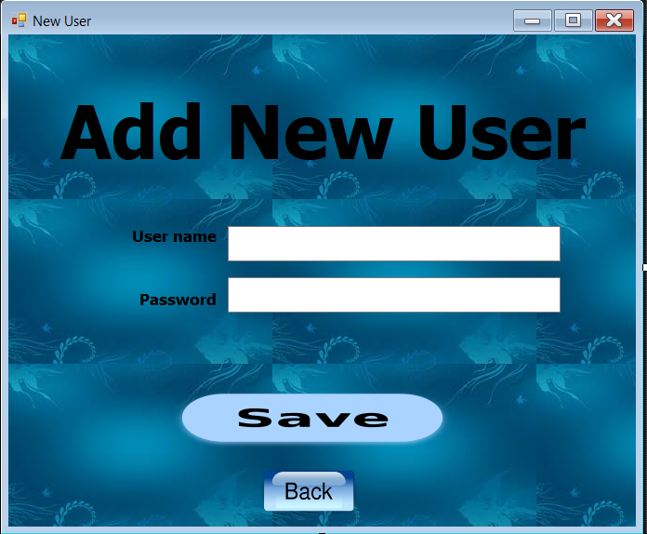
Add New User form
And here you can new user

Slide 14
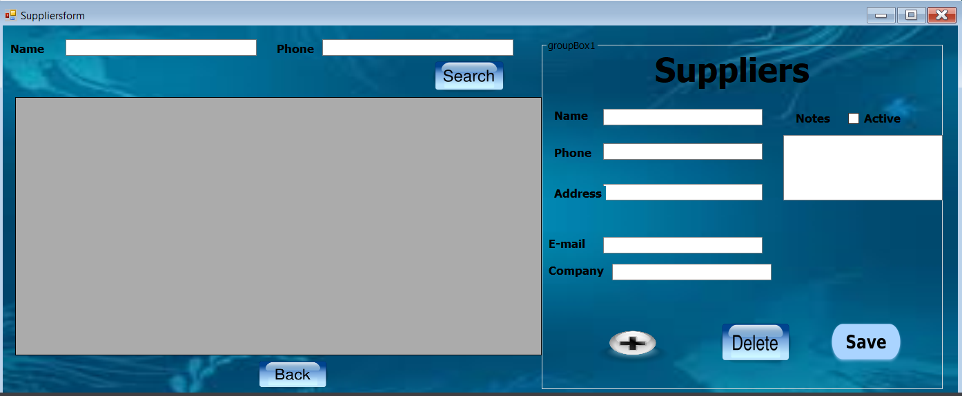
Suppliers form
Here you can view all suppliers and search for them by name and phone, and you can also add, edit and delete suppliers

Slide 15
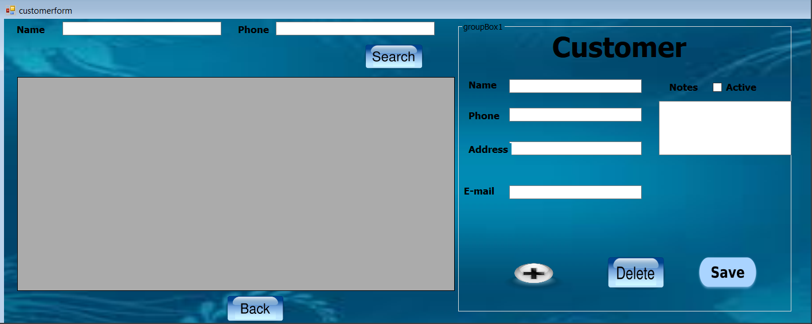
Customers form
Here you can view all customers and search for them by name and phone, and you can also add, edit and delete customers

Slide 16
Bonus code:
https://ideone.com/1VO86j
#include <bits/stdc++.h>using namespace std;struct BigInt {#define CUR (*this) const int BASE = 2; string v; BigInt() { } BigInt(string s) { v = s; reverse(v.begin(), v.end()); while (v.size() && v.back() == 0) v.pop_back(); } BigInt(const long long &val) { CUR = val; } int size() const { return v.size(); } bool zero() const { return v.empty(); } BigInt &operator=(const BigInt &a) { v = a.v; return CUR; } BigInt &operator=(long long val) { v.clear(); while (val) { v.push_back(val % BASE); val /= BASE; } return CUR; } /*****************************compare*****************************/ bool operator<(const BigInt &a) const { if (a.size() != size()) return size() < a.size(); for (int i = size() - 1; i >= 0; i--) { if (v[i] != a.v[i]) return v[i] < a.v[i]; } return false; } bool operator>(const BigInt &a) const { return a < CUR; } bool operator==(const BigInt &a) const { return (!(CUR < a) && !(a < CUR)); } bool operator<=(const BigInt &a) const { return ((CUR < a) || !(a < CUR)); } /*******************************add*******************************/ BigInt operator+(const BigInt &a) const { BigInt res = CUR; int idx = 0, carry = 0; while (idx < a.size() || carry) { if (idx < a.size()) carry += a.v[idx]; if (idx == res.size()) res.v.push_back(0); res.v[idx] += carry; carry = res.v[idx] / BASE; res.v[idx] %= BASE; idx++; } return res; } BigInt operator-(const BigInt &a) const { BigInt res = CUR; int idx = 0, carry = 0; while (idx < a.size() || carry) { if (idx < a.size()) carry -= a.v[idx]; if (idx == res.size()) res.v.push_back(0); res.v[idx] += carry; carry = res.v[idx] / BASE; res.v[idx] -= carry * BASE; while (res.v[idx] < 0) {

Slide 17
res.v[idx] += BASE; carry--; } idx++; } return res; } BigInt &operator+=(const BigInt &a) { CUR = CUR + a; return CUR; } /***************************multiply****************************/ BigInt operator*(const BigInt &a) const { BigInt res; if (CUR.zero() || a.zero()) return res; res.v.resize(size() + a.size()); for (int i = 0; i < size(); i++) { if (v[i] == 0) continue; long long carry = 0; for (int j = 0; carry || j < a.size(); j++) { carry += 1LL * v[i] * (j < a.size() ? a.v[j] : 0); while (i + j >= res.size()) res.v.push_back(0); carry += res.v[i + j]; res.v[i + j] = carry % BASE; carry /= BASE; } } while (!res.v.empty() && res.v.back() == 0) res.v.pop_back(); return res; } BigInt &operator*=(const BigInt &a) { CUR = CUR * a; return CUR; } /*****************************Division****************************/ BigInt &operator>>=(const int &a) { v = v.substr(a); return CUR; } friend ostream &operator<<(ostream &out, const BigInt &a) { out << (a.zero() ? 0 : a.v.back()); for (int i = (int) a.v.size() - 2; i >= 0; i--) out << (int) a.v[i]; return out; }#undef CUR};string convert_to_binary(char ch, int len) { string res; for (int i = 0; i < len; i++) { res = char((ch & 1)) + res; ch /= 2; } return res;}string convert_to_binary(string s, int bits_per_char) { string res; for (char ch: s) { res += convert_to_binary(ch, bits_per_char); } return res;}string convert_to_binary(int x) { string res; while (x > 0) { res = char(x & 1) + res; x >>= 1; } return res;}int main() { string s; int mod; while (cin >> s >> mod) { string bin = convert_to_binary(s, 8); string binmod = convert_to_binary(mod); BigInt MOD(binmod), target(bin); BigInt st = 1, ed(bin), ans = 0; while (st <= ed) { BigInt md = st + ed; md >>= 1; if (md * MOD <= target) { ans = md; st = md + 1; } else ed = md - 1; } BigInt res = target - ans * MOD; int out = 0; for (int i = 0; i < res.size(); i++) { out += (1 << i) * res.v[i]; } cout << out << endl; }}

Slide 18
Code Link in Github:
https://github.com/ramymonazaa/SuperMarket

